Slide 1
Election Equipment Evaluation Committee
June 28, 2023

Slide 2
AGENDA
Call Meeting to Order
Demonstration Wrap-Up
Vendor Discussions
Command Central – Dominion
Clear Ballot
ESS – Express Vote
Determine our Recommendation
Absentee Envelope Re-Design
Extra cost due to color re-design
Estimate of amounts needed
Next Steps
Next Meeting
Adjourn

Slide 3
COMMAND CENTRAL/DOMINION-ICE
PROS | CONS
New Machines (2yrs newer than DS200) | Unfamiliarity/not user friendly
One Machine | Higher Initial Cost
Ballot Building | One machine-less accessibility/single point of failure, delay in voting lines if machine being used for ADA
No additional fee for telephone/onsite maintenance/technical support (1hour turn around for onsite support on election day) | Additional poll work hands-on involvement/poll worker activation card? (Poll worker must enter information for ADA voters/accessing correct ballots/need to relocate ballots from write-in bin to larger bin, if necessary).
American made/assembled in the US | Compact flash cards (2 for each machine)
Separates write-ins | Device is 40+ lbs. – 2-3 people to lift on to bin/remove paper jams
Ballot Review option | Machine is longer – storage concerns
ADA accessories included in cost of primary machine | Machine takes 5-6 minutes to boot up
7 hour battery life | Sensors did not pick up minimal marks on ballot (20% of oval must be filled)
Backup cards (election files) provided to the County for each election for each municipality | One key per machine
Collapsible case – not currently available | Privacy concerns for ADA use
 | Main screen is not a touch screen
 | Requires 5 seals
 | Fonts not adjustable on screen

Slide 6
CLEAR BALLOT
PROS | CONS
Ability to adjust fonts and contrast | No modem capabilities
More compact for storage | One key for all locks (2 keys come with each machine)
Storage cases | Requires multiple seals
Collapsible ballot box option | Seal must be broken to unjam machine
Multi language capabilities | No auxiliary ballot bin (comes with separate red bag)
Vote Visualization – for use by Board of Canvass | Requires password to open and close polls
Secure link can be provided to view ballots for public records requests | Had to pick correct municipality on election day
4 hour battery life
Weighs 27 lbs.
Ballot bins/canvass bags come with bins
2 USB thumb drives, one with election info, the other to backup information
Visual editing tools for programming/creating ballots
ADA machine comes with printer
10 seconds to boot up

Slide 7
ES & S
PROS | CONS
Error Prompts/Alerts | Old Machines
Familiarity | DS200 Paper jams/feed ability
Mobility/Storage Capacity | Bin construction/locks
Ease of clearing ballot jams | DS200 Life expectancy/storage of thermal ballot paper
Two units – more accessibility
USB Drives
File retrieval/security
Lower initial cost for Express Vote
Express Vote thermal ballot paper good for 7 years
Weighs only 25lbs
Can be used for absentee in-person/SVD
No charge for software upgrade
Fonts and contrast adjustable
Multi language capabilities
Possible decrease in the amount of pre-printed ballots
Can be used by any voter
No ink/toner cartridges
Rolling ballot box

Slide 10
ABSENTEE BALLOT REDESIGN
WEC to meet in August for final approval of envelopes.
Expect increase cost due to color.
Printer requesting approximate pre-order amount.
All previous envelopes may not be used and must be destroyed.
Lincoln County will submit envelope sub grant pm on behalf of the municipalities if in agreeance.

Slide 11
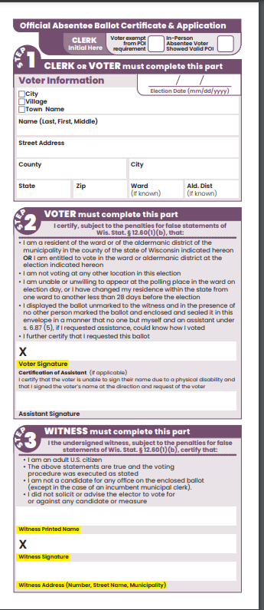
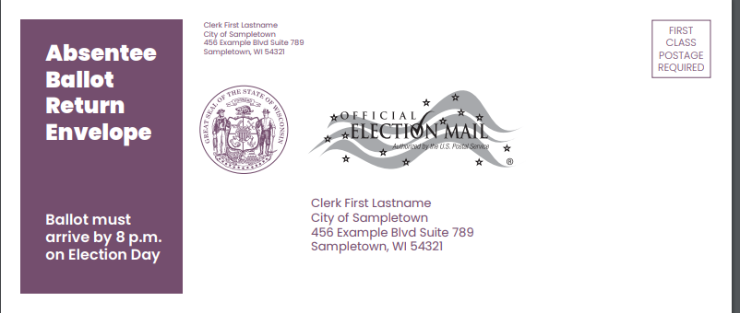

Slide 12
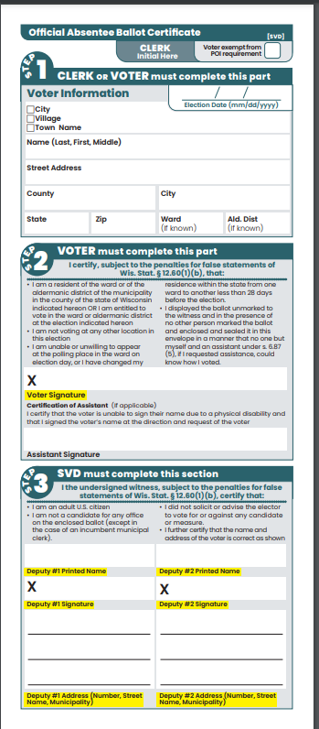

Slide 13
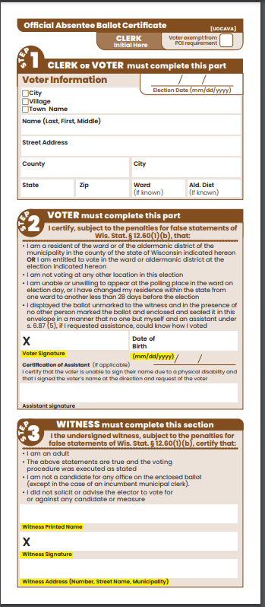
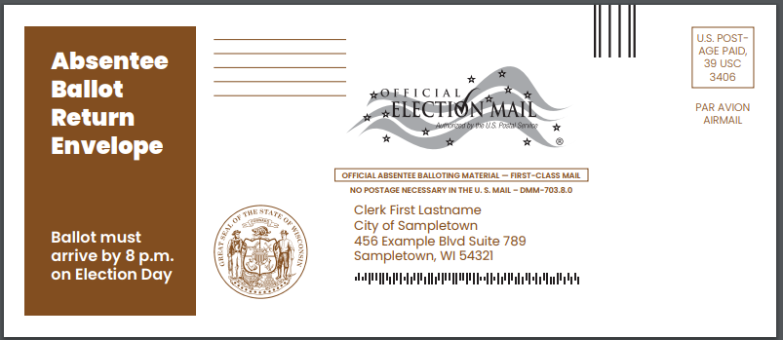

Slide 14
