Slide 1
Memorandums of understanding (Mou)
WisVote
Maintenance Agreements
Review and sign with Town Boards
Return to County Clerk’s Office by December 31, 2023.

Slide 2
2024-2025 Calendar of Election Events
The 2023-2024 Calendar of Election Events is now available for clerk review.
You can find the 2023 and 2024 Calendar of Election Events available online at: https://elections.wi.gov/resources/quick-reference-topics/2023-2024-calendar-election-events .
As a reminder, the calendar of election events no longer includes campaign finance filing deadlines. For campaign finance deadlines visit the Wisconsin Ethics Commission website: ethics.wi.gov/.

Slide 3
Upcoming elections
February 20, 2024 – Spring Primary (if necessary)
April 2, 2024 – Spring Election & Presidential Preference Primary
August 13, 2024 – Primary Election
November 5, 2024 – General Election

Slide 4
MUNICIPAL CLERK TRAINING
Under Wisconsin law, each municipal clerk must attend training sponsored by the Wisconsin Elections Commission every two years. Wis. Stat. § 7.15(1m). In order to comply with this training requirement, municipal clerks must obtain six hours of training every two-year term, beginning January 1 of even-numbered years and ending on December 31 of odd-numbered years. EL 12.03(2).
Training “sponsored” by the WEC includes any training for municipal clerks that the WEC approves. This includes, but is not limited to, election trainings conducted by county clerks, online training presentations, and election administration or WisVote webinar sessions, either live or recorded. EL 12.03 (4), (5)

Slide 5
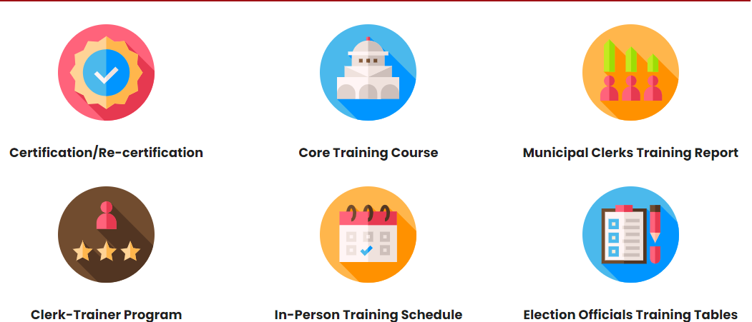
MUNICIPAL CLERK TRAINING
Training information can be located on the Wisconsin Elections Commission Website
file:///O:\Elections\Election%20Administration\Training\2023%20November%20Clerk%20Training.pptx
Click on drop down next to “Clerks”
Click on “Clerk Training”
Click on any one of the following icons for additional information:

Slide 6
Municipal Clerk Training
Core Training located in The Learning Connection and Live/Pre-Recorded Webinars count towards training hours.
Webinars can be accessed from the The Learning Center (TLC) or from the posted training event on the WEC calendar.
https://electiontraining.wi.gov
https://elections.wi.gov/calendar
If you do not have access to The Learning Center, please contact the WEC Help Desk (608)261-2028

Slide 7
New training webinar series
New Clerks Class: September 27, 2023
New Absentee Certificate Envelope: October 11, 2023
Appointing Election Officials for the 2024-2025 Term: October 25, 2023
What to Expect in a Polling Place Review: November 1, 2023
Back to Basics: The Photo ID Law: January 10, 2024
UOCAVA & You: Preparing, Sending, & Recording Military & Overseas Ballots: January 24, 2024
Contingency Planning: January 31, 2024
Preparing for the 2024 April and Presidential Preference Election: February 28, 2024
Spring Elections Wrap-Up: May 1, 2024

Slide 8
ELECTION SUBGRANTS (New Forms)
All current and future WEC subgrant programs contain revised language in the Documentation section that more specifically highlights the federal requirements regarding the mandatory equipment inventory list and includes a new subgrant requirement that you provide to the WEC your inventory list for any Equipment purchased with subgrant funds. There is also a new Equipment Inventory List template in Excel posted for this new subgrant requirement. Open until June 30, 2024.
2023 Accessible Voting Equipment
https://elections.wi.gov/memo/2023-accessible-voting-equipment-subgrant-reimbursement-program
Equipment Inventory List (will be completed by the Lincoln County Clerk’s Office)
https://elections.wi.gov/sites/default/files/documents/Equipment%20Inventory%20List%20-%20template.xlsx

Slide 10
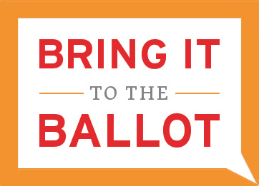
VOTING IN WISCONSIN - AND - THE VOTER PHOTO ID LAW
Wisconsin Elections Commission

Slide 11
WEC NEW PHOTO ID GUIDE
Updated Photo ID Guide is Published on the WEC Website or at https://bringit.wi.gov
Have you checked out the Voter pages on elections.wi.gov? Now is a great time to get familiar with the content there ahead of the 2024 election cycle. These pages were built with voters in mind to answer their questions about how to register, rules around accessible voting, concerns about special situations like being deployed in the military, living overseas or in a care facility, and what kind of acceptable photo ID to use. In fact, all the content regarding photo IDs that is on the Bring it to the Ballot site is now on the Voter Photo ID page.
This document has been updated for 2024 with a new layout, a more accessible font, updated web links, and the statutory deadlines.

Slide 12
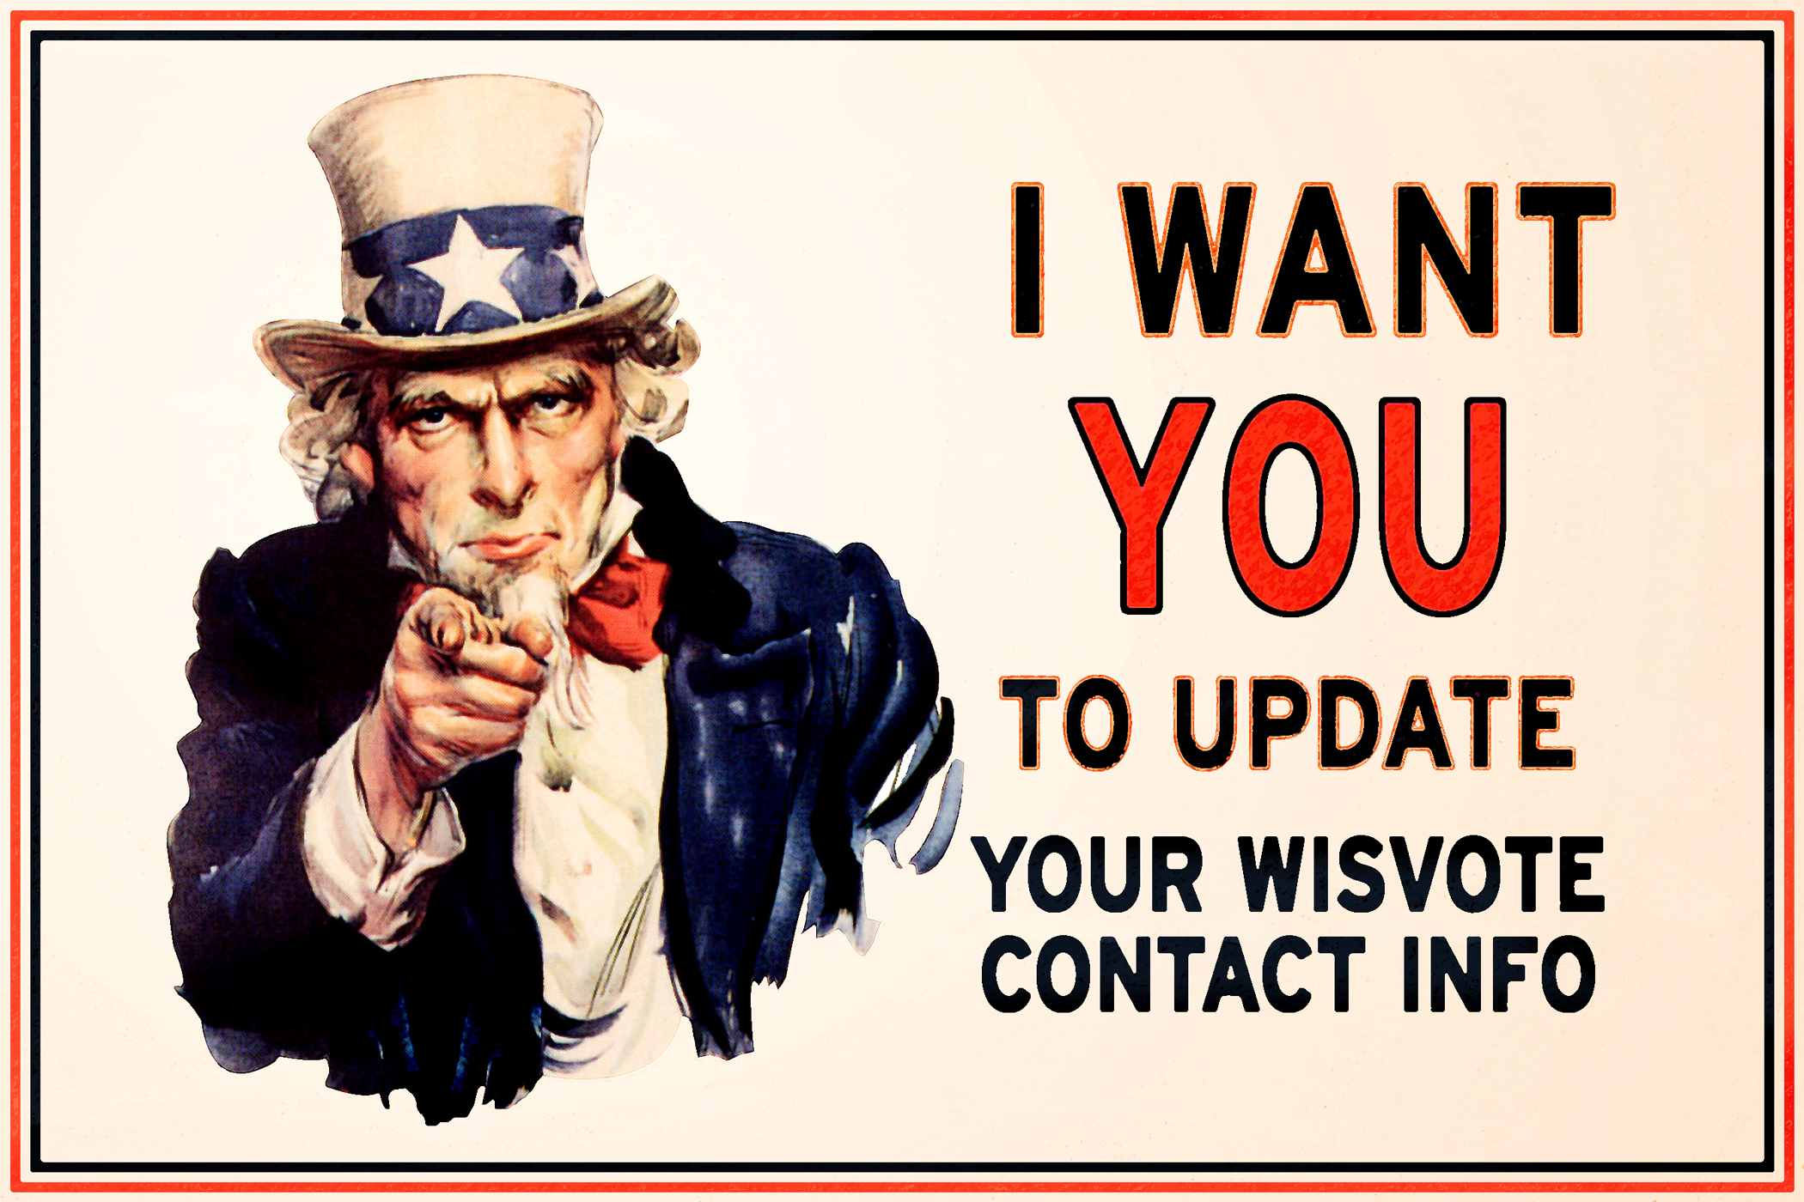
UPDATING CONTACT INFORMATION MYVOTE
Make Sure Voters Can Find You! Check your staff info on MyVote Maintaining your contact information and staff list in WisVote is crucial for ensuring that voters can contact your office and that only active election officials have access to this sensitive database. You can easily verify that your municipality's clerk contact information is correct by using MyVote. Also, as a matter of routine, please keep the WEC Helpdesk aware of any incoming staff members who need WisVote access, or outgoing staff members whose access should be removed, and the dates to change their access. Please contact the WEC Helpdesk if you have any questions about your staff's credentials for WisVote.

Slide 13
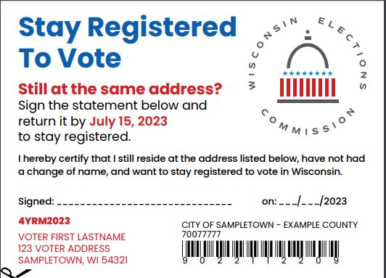
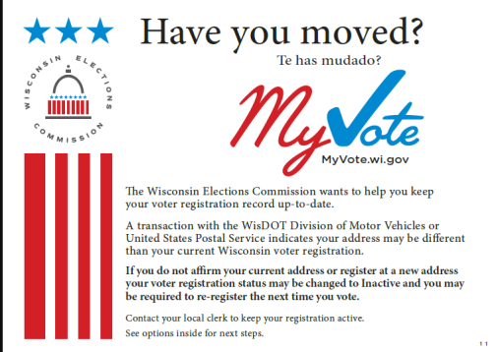
WEC VOTER MAINTANANCE
REMINDER If you do not manage voter maintenance cards in WisVote, please forward to the County Clerk’s office upon receipt (hand deliver, mail, email). The WEC requires specification voter notification and/or documentation within the system to avoid deactivation of a voter’s account. This will require the voter to re-register to vote.

Slide 14
ES&S
Delivery of New Equipment January 4, 2024
Drop off of DS200s and AutoMarks Preparation of Equipment for Transport January 4th or January 5th (am)
Installation/Upgrades/Maintenance Week of January 8th-11th
Training and Pickup of Equipment Thursday, January 11, 2024 (AM and PM classes)

Slide 15
Updates
Absentee Envelopes Order Placed with Reindl
Additional Seal for DS200 Paper Seal
Quarterly Clerk Meetings/Additional Clerk Training Absentee Management in WisVote Test Decks Other (recommendations/ideas)
Meetings Fall, Early Spring, Summer, End of Year? Mandatory/Non-mandatory

