Slide 1
Lincoln County Poll Worker Training March 21, 2024 (6:00-7:00PM) March 22, 2024 (1:00-2:00PM)

Slide 2
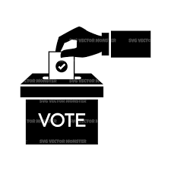
February 20, 2024 Primary Election
April 2, 2024 Presidential Primary & Spring Election
August 13, 2024 Partisan Primary
November 5, 2024 General Election

Slide 3
Note: March 29, 2024 is Good Friday. Municipal Clerk’s will need to be available until 5:00pm for in-person absentee voting. A note can be placed on the Town Hall door with contact information. Type E published.

Slide 4
TRAINING OPPORTUNITIES
Lincoln County Clerk’s Office
Municipal Clerk Training
Poll Worker Training
Election Equipment Training
WEC
ElectEd (Online Training)/Webinars
WI Towns Association/WI Municipal Clerks Association roundtable discussions or presentations given by the WEC
Municipal Clerk
In-person
Vimeo Channel (https://vimeo.com/showcase/9655210 )

Slide 5
Election Inspectors/Poll Workers Training Requirements

Slide 6
MCT CERTIFICATION HOURS REPORTING FORM
This form should be filled out and submitted to the WEC for recording of training hours. (Handout #1)

Slide 7
ELECTION OFFICIALS
Chief Inspector - In charge of the polling place on election day. Chief inspectors must take the 3-hour Baseline Chief Inspector training class before their first election to be certified to conduct the elections. Chief inspectors must take a total of 6 hours of election training each 2-year term to recertify for the following term. -Must have one on duty at all times
Election Inspectors/Poll Workers - Must have at least three poll workers (Includes the Chief Inspector) - State Law requires the municipal clerk to provide some type of election training to election inspectors, but does not prescribe the length of the training or establish a curriculum.
Greeter/Tabulators -Determine the need for a Greeter (Page 22 Election Day Manual) - Greet voters on Election Day and help direct them toward the voter registration table or poll book table. Tabulators are brought in at the end of the night to help count votes. - Greeters can be appointed regardless of part affiliation and may temporarily serve as an election inspector to cover breaks, unexpected absences, however greeters may not count votes or participate in the canvass after the polls close. NOTE: A greeter is not included in the total number of election officials.
Election Registration Officials (ERO) – ideally trained as inspectors - Can register voters at the polls on Election Day, in the clerk’s office during in-person absentee voting or at residential care facilities during open registration.
Special Voting Deputies (SVDs) – Appointed and trained by the local clerk and work from 22 days (4th Monday) before the election until election day to conduct absentee voting in Nursing Homes and Assisted Living Facilities, ideally inspectors)

Slide 8
PREPARING TO SERVE
Attend Pre-Election/Election Day Training
Read the Election Day Manual
Work with your team
Number of Election Inspectors
Any Inspectors appointed by a political party?
Greeter? Election Registration Official?
End of Line Officer
Contingency Plans
Please Note: Shadowing – Per the WEC, new poll workers either have to be full poll workers that count towards your total and follow party imbalance or they can be observers. If observers, they must follow observer guidelines.
Invite your election inspectors to the public test
Familiarize yourself with the ballot and equipment
Arrive at the polling place early

Slide 9
YOUR JOB IS TO…….
Facilitate the democratic process
Set-up the polling place before the doors open at 7:00 a.m. on Election Day
Be ready to process voters when they arrive to vote
Reminder: during down times poll workers may be allowed to use cell phones, read books, knit, etc. with good judgement

Slide 10
ASSISTANCE TO VOTERS
All voters may use the accessible voting equipment
Poll workers should be familiar with how the voting equipment operates
All voters may receive assistance from a poll worker or another assistant
Assistant cannot be the voter’s employer or labor union rep
Explaining and filling out the Voter Registration form.
Stating Name and Address at the Poll Book on voter’s behalf.
Assistance with filling out ballot or using accessible voting equipment.
Assistance with placing a ballot in box or machine.
Assistance with curbside voting

Slide 11
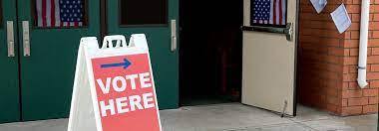
POLLING PLACE SET UP
Chief inspectors should know the order of flow for their polling location.
Before election day, the chief inspector should consult with the municipal clerk about the layout of the polling place. Be familiar with the flow of traffic and make sure that the polling place is accessible/
When planning the layout of the polling area consider the following:
Voting Booths: how many do you need and what size do you need? Are there any spacing concerns? Also include supplies such as marking pens or pencils for voters to use to fill out their ballots in the voting booths.
Ballot boxes: how many ballot boxes do you need and where will they be located? Special attention needs to be paid to ballot box security.
National flag: The American flag must be displayed either inside or outside of the polling place; some municipalities choose to display the flag both inside and outside of the polling area.
Tables and chairs: make sure you have tables for voters to use to fill out a voter registration form. Chairs situated throughout the polling area can be helpful for voters waiting in line who may have difficulty standing for very long.

Slide 12
POLLING PLACE SET UP (CONT)
Review the Election Day Accessibility checklist with the municipal clerk. Accessibility is not limited to just the polling location but to the entire route of an elector from the moment they enter the parking lot until they vote and exit the polling area. Accessibility audits are conducted during most elections to make sure that polling places are compliant and accessible.
Wisconsin has required that polling locations be accessible to the elderly and voters with disabilities since 1985. Federal HAVA laws has added a new emphasis to this requirement.
Making sure that the polling place is accessible is something that the municipal clerk should already have done but, it is good for all election officials at the polls to be aware of this. We HIGHLY recommend using the polling place accessibility checklist as the set up on Election Day affects access.
To ensure that the equipment is working and that there is adequate privacy in place, we recommend that every election inspector cast their ballot using the accessible equipment.

Slide 13
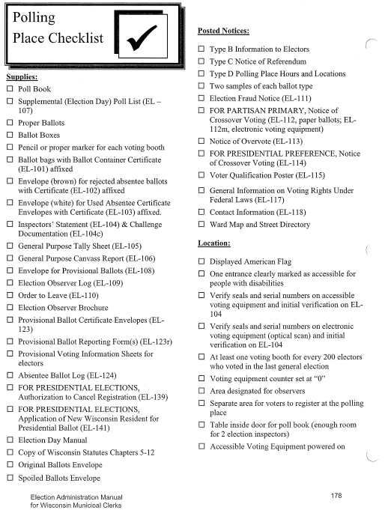
POLLING PLACE SET UP (CONT)
The Polling Place Checklist is in your manual. The municipal clerk should provide a copy of this checklist.
This checklist lists the materials needed at the polling place on Election Day, including forms, ballots, notices, voter information and other supplies.
One of the many important reasons for getting to the polling place early is so that you can discover anything that is missing right away BEFORE the polls open.

Slide 14
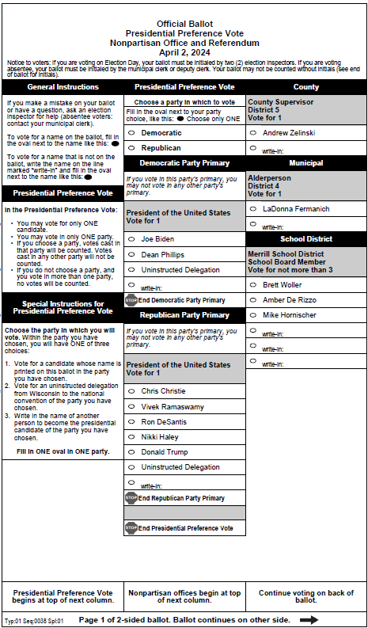
WHAT’S ON THE BALLOT?
FEDERAL
Presidential Preference Vote (Vote for 1)
COUNTY (Vote for 1)
Lincoln County Board of Supervisors
– District 1-District 22
MUNICIPAL
Merrill Alderperson (District 1-District 8)
Tomahawk Alderpersons (District 1-District 3) (Vote for 1)
Ed Nystrom (Wards 1&2)
Will Garske (Wards 2&4)
Michael Loka (Wards 5&6)
Tomahawk Mayor (Vote for 1)
Steven Tasakay
Bradley Town Board Supervisor (Vote for 2)
John Crass
Jennifer Bishop
Merrill Town Board Supervisor (Vote for 2)
Tim Mueske
Scott Oberg

Slide 15
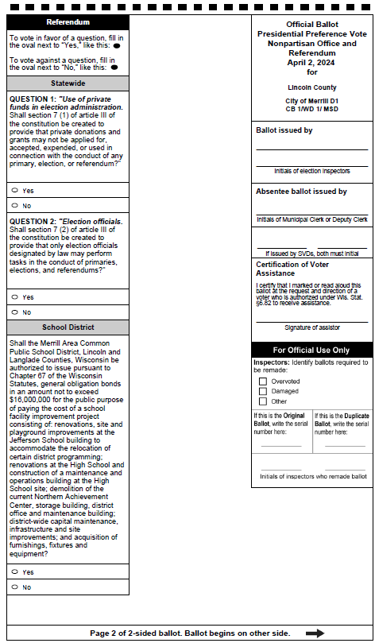
WHAT’S ON THE BALLOT (CONT.)
SCHOOL BOARDS
Merrill Area School District Board Members (Vote for 3)
Brett Woller
Amber De Rizzo
Mike Hornischer
Prentice School District Board Members
Rhinelander School District Board Members (Vote for 3)
Patricia Townsend
Benjamin Roskoskey
David Holperin
Ronald Counter
Tomahawk School District Board Members (Vote for 1)
Deb Velleus, Towns of Bradley, Brich, Skanawan, Tomahawk and Rock Falls
Shar Kirsch, City of Tomahawk

Slide 16
WHAT’S ON THE BALLOT (CONT.)
REFERENDA
State
Use of private funds in election administration.
Election Officials.
School Districts
Merrill – Authorization to issue general obligation bonds in the amount not to exceed $16000,000 for public purpose of paying the cost of a school facility improvement project.
Prentice – Shall the School District of Prentice, Price, Oneida and Lincoln Counties, WI be authorized to exceed the revenue limit specified in Section 121.91, WI Statutes by $1,800,000 beginning with the 2024-2025 school year for recurring purposes consisting of operation and maintenance expenses.
Rhinelander - Authorization to issue general obligation bonds in the amount not to exceed $26,000,000 for the public purpose of paying the cost of a school building and facility improvement project.
WRITE-INS
City of Tomahawk School District – Lonny Calhoun
Not displayed at polling location, however provided if asked.

Slide 17
STATE REFERENDUMS
QUESTION 1: “Use of private funds in election administration. Shall section 7 (1) of article III of the constitution be created to provide that private donations and grants may not be applied for, accepted, expended, or used in connection with the conduct of any primary, election, or referendum?”
The Wisconsin Constitution does not limit the ability of the state or local governments to receive non-governmental grants, funds, or equipment to assist in carrying out election-related responsibilities. Question 1 would add a new provision to the Constitution to prohibit the state or local governments from applying for, accepting, expending, or using such funds to assist with carrying out “any primary, election, or referendum.” The question would appear to apply to any type of non-governmental grant or funding, no matter how general in scope.
A “yes” vote on Question 1 would vote to create a new provision of the Wisconsin Constitution—Wis. Const. art. III, § 7(1). That provision would prohibit a state agency or local government from applying for, accepting, expending, or using any non-governmental moneys or equipment in connection with the conduct of any election.
A “no” vote on Question 1 would vote not to add Wis. Const. art. III, § 7(1) to the Wisconsin Constitution.

Slide 18
STATE REFERENDUMS
QUESTION 2: “Election officials. Shall section 7 (2) of article III of the constitution be created to provide that only election officials designated by law may perform tasks in the conduct of primaries, elections, and referendums?”
Wisconsin statutes define and regulate how clerks can designate individuals to serve as election officials and carry out various tasks relating to elections. The Wisconsin Constitution does not separately spell out which individuals can do that work.
Question 2 would add a new provision to the Constitution to prohibit individuals from performing tasks related to an election unless they are an “election official designated by law.” Under current statutes, clerks have the statutory power to designate individuals to carry out election-related tasks, and so such designated individuals could continue doing their work as an “election official designated by law.” But that power is only statutory, and if the statutes changed, the new constitutional provision would bar clerks from designating individuals to assist with election-related tasks.
A “yes” vote on Question 1 would vote to create a second new provision of the Wisconsin Constitution—Wis. Const. art. III, § 7(2), which would prohibit an individual from performing election-related tasks unless they are an “election official designated by law.”
A “no” vote on Question 1 would vote not to add Wis. Const. art. III, § 7(2) to the Wisconsin Constitution.

Slide 19
DS200 DIGITAL PRECINCT SCANNER
The DS200 is a precinct-level tabulator that can also be used as a central count tabulator for voting over an extended period, as with early or absentee voting. Both one-and-two sided ballots can be read by the DS200 to determine valid ballot marks and extraneous marks, such as smudges or folds. All election results are stored on an encrypted removal USB flash drive, which is used to transfer results to the Electionware Results module.
Handout #2 DS200 Quick Start Guide
Handout #3 DS200 Poll Workers Guide

Slide 20
BLACK BOX CONTENTS
PASSWORDS – Now 4 - Qualify Code - Election Code - Override Code - Admin Code
MEDIA STICKS – Now 3 - Qualify - DS200 - ExpressVote
PAPER x2
KEYS – IF LEFT IN BOX
SEALS
- PAPER-NEW
Replacing red seal for DS200
- Green x2
1 on box for pickup
1 in box for return
- Red
1 for backup to paper seal for DS200

Slide 21
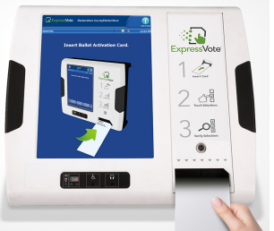
EXPRESSVOTE ACCESSIBLE VOTING EQUIPMENT
ALL VOTERS CAN USE ACCESSIBLE VOTING EQUIPMENT AND SHOULD BE ENCOURAGED TO DO SO
The ExpressVote can… -Be used for in-person absentee voting -Read a voter their ballot -Make text bigger -Change the contrast of the screen -Warn a voter if they overvote or skip a contest
REMINDER: Please take care when plugging in and unplugging the cord for the ExpressVote machine.
Handout #4 (ExpressVote Poll Worker’s Fact Sheet) Handout #5 (ExpressVote Quickstart Guide)

Slide 22
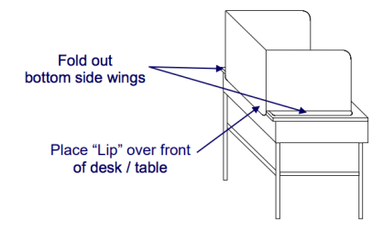
ELECTION EQUIPMENT
Privacy Shields
privacyshields.com
Storage of Equipment
Secure Climate Controlled Location un-accessible to the public
Seals should be utilized as a secondary precaution to ensure equipment has not been tampered with.
Keys
Key Storage Location
Who has Access?
Access List?
Treat as all other town keys.

Slide 23
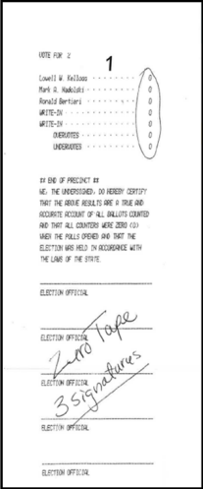
EQUIPMENT TEST REQUIREMENTS
PUBLIC TESTS
Each public test must have an errorless count before the equipment can be used in an election.
Wisconsin law requires that all electronic voting equipment be tested for accuracy prior to use in an election . Also call the “Public Test”. Public notice of the test must be giving at least 48 hours prior. Public test is conducted nor more than 10 days before election. Any test conducted 11+ days in advance must be redone. Pre-testing outside 10-day window is acceptable. All tabulators, DREs, and BMDs used on election day must be publicly tested. (Note: Utilize a few ExpressVote ballots into your test)
ELECTION DAY
Prior to the opening of polls, election officials witness a test of the tabulator by printing a zero tape showing zero votes.
- Signed by an odd number of Election Officials - Minimum of 3 signatures - Do not rip off zero tape
There will be an
Additional results
Tape that prints – to be
Returned to the County Clerk’s
Office

Slide 24
TYPES OF VOTER REGISTRATION
REGULAR
Regular registrations are done prior to the deadline closing registrations done on-line or by mail.
These voters will appear in the poll books.
LATE REGISTRATIONS
Registrations done in the clerk’s office prior to the close of late registration.
These voters should be located in the supplementary poll list located at the back of your poll book.
These voters may appear in the poll book if the voter was entered into WisVote prior to the poll books being printed.
If the voter claims to have registered late with the clerk or on-line and they are not found in either the supplemental list or the regular list. One of these requirements must be met:
The voter obtains a copy of their MyVote registration verification.
Your clerk can verify that they did register late and the registration is on file.
All other occurrences require an Election Day Registration.
Always document irregularities, such as this, on the Incident Log.
ELECTION DAY REGISTRATIONS (EDR)
Document the number of EDRs on the Inspector Statement in the Voter Statistics Section. This must be documented correctly as seen in the LB Audit Report.

Slide 25
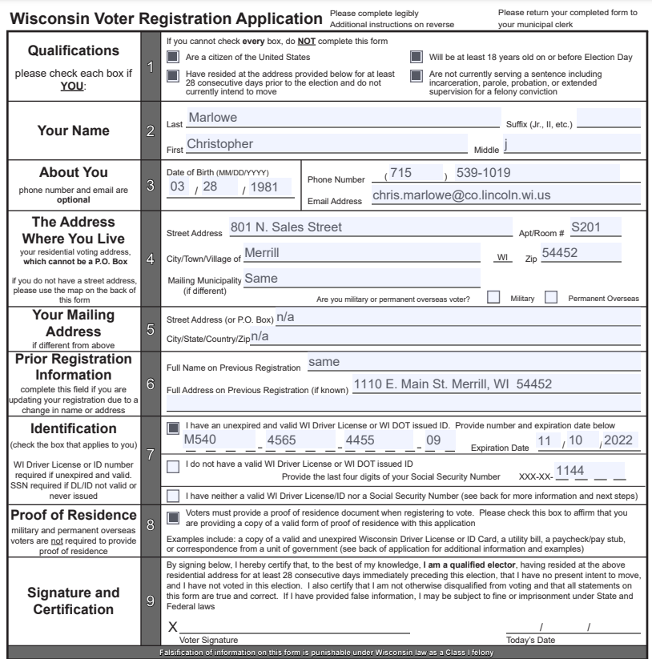
ELECTION DAY REGISTRATIONS
ALL QUALIFICATIONS ARE MET
FULL NAME WITH MIDDLE INITIAL
ATTEMPT TO COLLECT ALL THREE BUT D.O.B. IS MANDATORY. MAKE SURE THEY DID NOT USE TODAY’S DATE.
FULL ADDRESS WITH VERIFICATION OF MAILING ADDRESS BEING THE SAME
CLEARLY NON APPLICABLE
LAST ADDRESS SHOWN PROVIDING CLERKS A RESIDENCE TRAIL TO HELP MATCH REGISTRATION WITH VOTERS OLD RECORD. CLERK’S WILL OFTEN NOTIFY ELECTION OFFICIALS IN PRIOR COUNTY OR STATE
OBTAINING BOTH D.L. NUMBER AND LAST FOUR DIGITS OF SOCIAL WILL ALSO HELP DEFEND AGAINST DUPLICATION AND FRAUD
VERIFICATION P.O.R. WAS SHOWN
SIGNATURE AND TODAY’S DATE
03/19/2024

Slide 26
ELECTION DAY VOTER REGISTRATION – EL-131
Official Use Only section of the Voter Registration Application
The election inspector must review the voter’s proof of residence. It the POR is valid, the inspector should circle the POR type, and list the POR issuing entity and POR # on application. For example, a utility bill would be the POR type, Madison Gas and Electric would be the POR issuing entity and the POR # would be the utility account number.
It’s important to note that not all types of POR have a unique number, but if they do, it should be recorded in the appropriate field. For numbers with 7 or more digits, list the last four digits; numbers with six or fewer digits, list the last two digits of the number.
If the application is complete and the POR is acceptable, the election official who received the application should date it.
Voters who register on Election Day are issued a voter number. This number should be recorded on the supplemental poll list.
The WisVote ID number is generated when the application is entered into the WisVote system.
The confidential elector number is issued to a voter who has registered in the clerk’s office through the confidential voter process.
If the registrant submitted the application by mail, this box should be checked.
Finally the election official who received the application should review it for completeness and legibility before signing it.

Slide 27
PROOF OF IDENTIFICATION
A voter must show the election inspectors managing the poll lists their proof of identification before receiving a ballot.
Proof of Identification, also referred to as photo ID or POI, is required to be shown to the election inspectors managing the poll lists before regular voters can be issued a ballot.
Proof of Identification Requirements include:
All photo IDs must contain a name, picture, and date of expiration.
WI Drivers’ License or State Issued ID
Military ID, including a retired military ID
Passport Book or Card
The name on the photo ID must conform to the voter’s name on the poll list, so Sue for Susan or Bob for Robert
The photo on the ID must reasonably resemble the voter. Keep in mind that people change over the years, they may gain or lose weight, color their hair or grow a beard.
Photo IDs must be unexpired. Exceptions to this requirement – University, College or Technical College ID. Must be accompanied by “proof of enrollment” which can be any document that establishes the student is enrolled during the current term such as a class schedule, tuition receipt or letter from the university or college. Tribal IDs are valid regardless of expiration date.

Slide 28
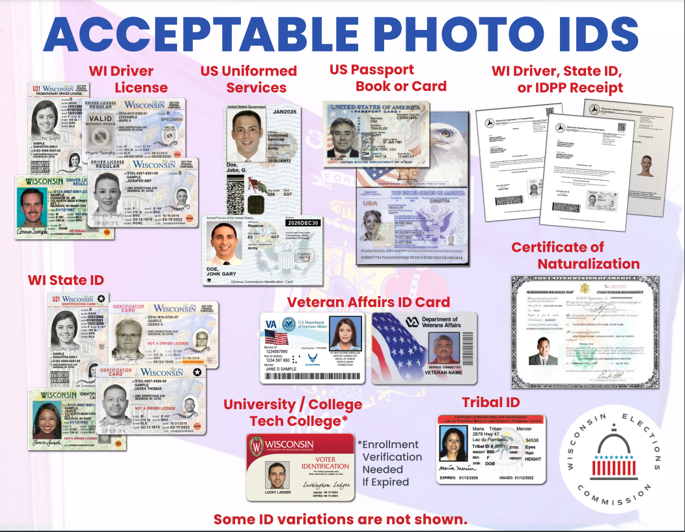

Slide 29
PROOF OF RESIDENCE
Proof of Residence must include the voter’s complete name and residential address.
Electronic Proof of Residency may be accepted. The voter can display their proof of residence on a device such as a smart phone or tablet.
Forms of Proof of Residency:
Unexpired WI Driver’s License or WI State ID card Other official or government-issued ID card Any identification car issued by an employer Real estate tax bill or receipt (current year or year before) Utility Bill Residential Lease Bank Statement, includes credit card statements, mortgage statements and retail credit card statements. Pay check or pay stub, including direct deposit documents University, college or tech college with a photo A letter on public or private social service agency letterhead identifying a homeless voter A contract or intake document prepared by a residential care facility that specifies that the occupant currently resides there.

Slide 30
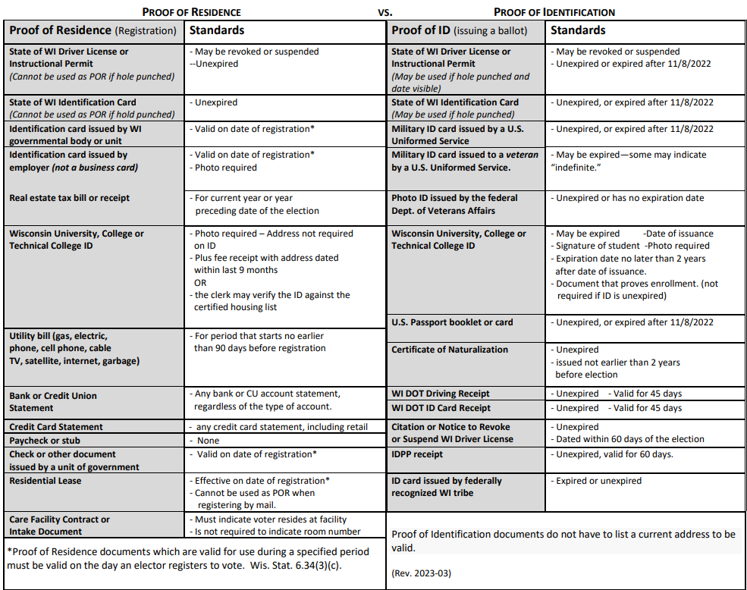

Slide 31
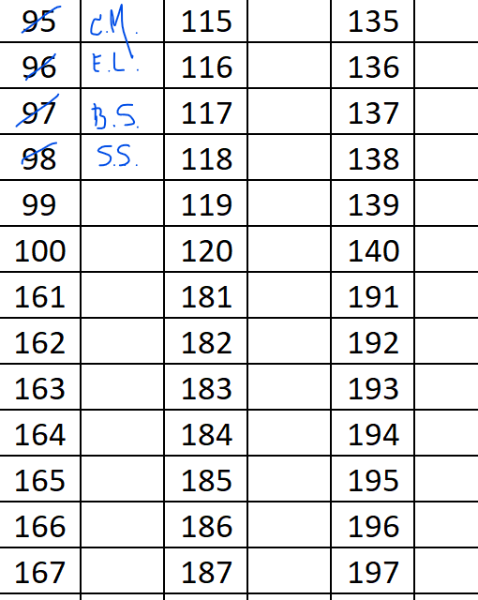
DECIDE ON DESIGNING A SYSTEM FOR ISSUING VOTER NUMBERS AND BALLOTS
Ask the voter for their name and address.
When found on the poll list, have the voter sign, then issue a number card.
Have the voter hand the inspector on the second poll list their name and number card. Once n umber is recorded on second list, retrieve the used number card and issue the voter a ballot.
Record the voter’s initials next to the number they are issued.

Slide 32
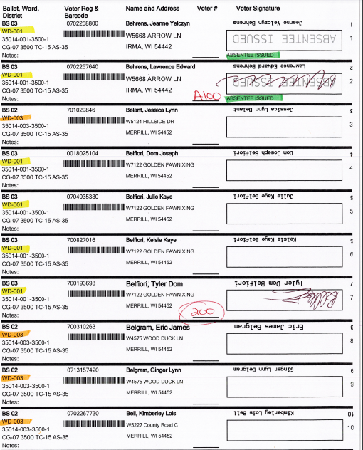
POLL LIST
The Clerk should prepare the poll book by updating the supplemental list and indicating ABS voter with a green marker or pen.
Notes may be made next to the voter names but change of name and change of address absolutely require a voter to update their registration by filling out a new EL-131 Voter Registration Form.
Compare poll lists often to ensure both books are on the same voter number.
All references of ABS (Absentee) voter numbers should be in red with the letter A in front.
Circle the last voter number in red and record the page number on the certification page. (First page of the Poll Book)
Also include on the certification the total number of absentee voters and the number of absentee ballots counted.
Municipalities with multiple wards and ballots may choose to color coordinate poll books with ballots to ensure poll workers are issuing the correct ballot.

Slide 33
INELIGIBLE VOTER LIST
Each polling place must have a list of ineligible voters. The list is generated by the state Department of Corrections and lists individuals in the municipality or county who are currently out of prison and still completing the terms of their felony sentence. They are not eligible to vote.
Election official must review the ineligible voting list for all election day registrations and absentee ballots before they are processed to confirm that the voter is eligible to vote.
If the voter’s name appears on the list and the voter indicates that they should be eligible to vote, contact the Wisconsin Elections Commission to verify the voter’s current status.
If the voter is confirmed eligible to vote, indicate their status on the EL-131 voter registration application, by writing “eligible to voter per DOC.”
If the voter is confirmed ineligible to vote, issue the ineligible voter information sheet, EL-119, and mark the voter registration application, “ineligible to vote per DOC.” If voter wishes to vote, the inspectors should challenge the ballot and follow the challenged ballot procedure.
If the inspectors are unable to contact the WEC, and the voter wishes to vote, the inspectors should challenge the ballot.
Handout #6 Ineligible Voter Information Sheet (EL-119)

Slide 34
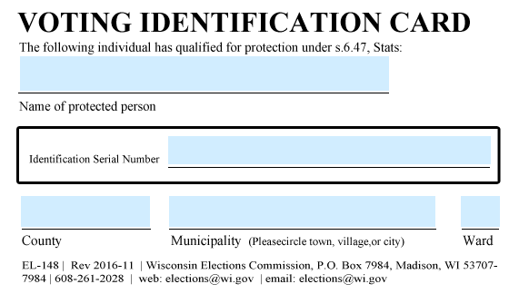
CONFIDENTIAL VOTERS
Confidential electors will present an Identification Card for protected individuals issued by the municipal clerk instead of announcing their name to the election inspectors managing the poll lists.
Confidential Electors who are victims of domestic abuse, sexual assault or stalking have the option to be listed confidentially on poll lists. An individual is eligible if he or she:
Has been granted a protective order that is in effect;
Has an Affidavit of Sheriff or Chief of Police (EL-147) which is signed by a sheriff, chief of police, or district attorney and verifies that the individual was a victim and continues to be threatened;
Resides in a shelter and provides a signed statement from the operator;
Or, the individual submits a statement signed by an authorized representative of a domestic abuse or sexual assault victim service provider.
Confirmation from the Department of Justice that the requester is a participant of the Safe at Home program.
Confidential electors do not have to provide proof of identification, but must still sign the poll list in the confidential elector section, located at the back of the poll list. This section of the poll list is not open to public inspection.

Slide 35
PROVISIONAL VOTING
In Wisconsin, provisional voting can only occur at the polling place on Election Day in two situations:
A voter who registers on Election Day, has a current and valid Wisconsin driver’s license or state-issued ID card, but is unwilling or unable to provide the number may vote provisionally.
A registered voter who is unable or unwilling to provide acceptable proof of identification when required may vote provisionally.
The voter fills out the provisional voting certificate envelope, the EL-123.
The election inspectors completes filling out the envelope by indicating which pieces of information are missing.
The inspector issues a provisional voter number, a sequential number starting labeled PV#1, PV#2 and so on.
This number is recorded on the poll list, the back of the voter’s ballot, on the provisional voter information sheet, the Inspectors’ Statement, the provisional voting certificate envelope and on the provisional voting report.
The voter votes the ballot and seals it inside the envelope.

Slide 36
PROVISIONAL VOTING (CONT.)
The inspector should hand the voter the Provisional Voter information sheet. The information sheet explains that vote will not be counted unless the missing information is provided to the municipal clerk by 4pm the Friday following the election.
The voter may also bring the missing information to the polling place by 8pm. Election Day.
The inspector will put the sealed envelope into the Inspector’s Certificate for Provisional Ballots Envelope.
The incident is recorded on the Inspectors’ Statement.
Inspectors will record all of the relevant information about provisional voters on the “Provisional Ballot Reporting Form (EL-123r)”. Name, Date of Birth, Address, PV#, if they voted absentee or in-person and reason for issued provisional ballot.
If the voter returns on Election Day with the missing information, the inspector should record the type of documentation provided by the voter, whether it was provided in-person, time, date initials of inspector and the voter number issued.

Slide 37
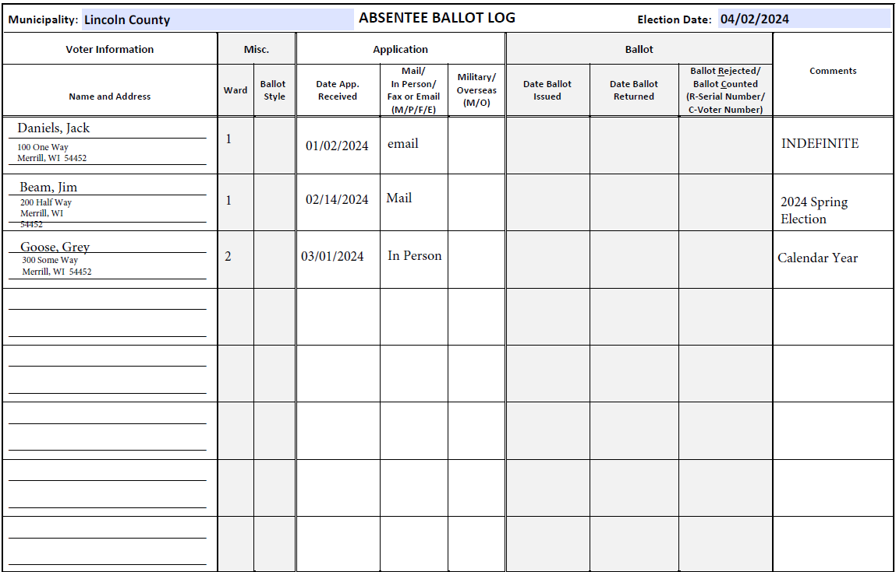
ABSENTEE BALLOT LOG (EL-124)
If the log indicates the voter returned the absentee ballot, the voter may NOT vote at polling place.
If the log indicates the ballot has not been returned ask if voter mailed or personally delivered to the clerk’s office?
If yes – voter cannot vote
If no – voter should be issued a ballot.
If ballot is later received, process and “rejected” and notify clerk
Always us the letter “A” and red ink when referencing Absentee (ABS) Voter Numbers.
All Absentee Voters should be on the log and marked returned when returned.
All counted Absentee Voters should have an Absentee Number.
Use the Incident Log to record if absentee ballots are remade/spoiled by inspector.

Slide 38
ASSISTING ELECTORS
If an elector informs the election inspector that he/she requires assistance marking his/her ballot, the election inspector should:
Give the elector a voter number and issue them a ballot.
The elector “must” sign the poll list.
If the elector cannot sign the poll list the election inspectors should write, “Exempt by order of inspectors” in the signature line.
Election inspectors should have signature guides and page magnifiers available for those electors who have difficulty seeing.
Record the name and address of the person assisting the elector on the poll list.
Electors may select any individual to assist them to cast their vote, including an election inspector. EXCEPTION The elector’s employer or an agent of labor organization that represents the elector may not assist the elector.
The person assisting the elector does not have to be a qualified elector.
A person who assists a voter must certify on the back of the ballot that it was marked with their assistance before depositing the ballot in the ballot box. This applies to the ExpressVote ballot as well.
NOTE: If a voter changes their mind about voting on ExpressVote after an ExpressVote ballot has been issued, the ballot must be spoiled and documented on the incident report and a paper ballot issued.
This incident should be recorded on the Inspectors’ Statement (EL0104).

Slide 39
CURBSIDE VOTING
The election inspectors announce in the polling place that an elector has requested a curbside ballot.
Two inspectors go to the vehicle to view voter’s proof of identification.
If having two inspectors leave the polling areas would result in fewer than three inspectors at the polling area, voting must stop until they return.
Inspectors return to polling area and announce they are issuing a ballot to the voter.
If the voter is able to enter the polling place, curbside voting may not be used.
The voter is not required to sign the poll list. A notation “Ballot received at poll entrance – “Exempt”. Is made in the signature line of he voter on the poll list.
Two inspectors initial the ballot. A voter number is issued and recorded in the voter lists.
The voter marks the ballot or has an assistor mark the ballot. (If assistor is used follow “Assisting Electors” guidelines).
Inspectors return to the voting area and announce “I have a ballot offered by voter and if anyone wishes to object the reception of ballot.
If objection is made follow “Challenging Electors” guidelines. If no objection or after challenge is resolved, deposit in appropriate ballot box.
THE INCIDENT SHOULD BE RECORDED ON THE INSPECTORS’ STATEMENT IN DETAIL.

Slide 40
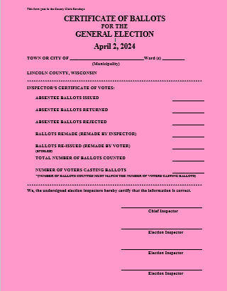
CERTIFICATE OF BALLOTS
The top section can be completed b the Clerk.
Ballots destroyed by elector error. Remade by the elector.
Damaged Ballots. Remade by the Poll Workers.
Total Ballots counted must equal the number of voters casting ballots.
If numbers do not match, be ready to explain what happened.

Slide 41
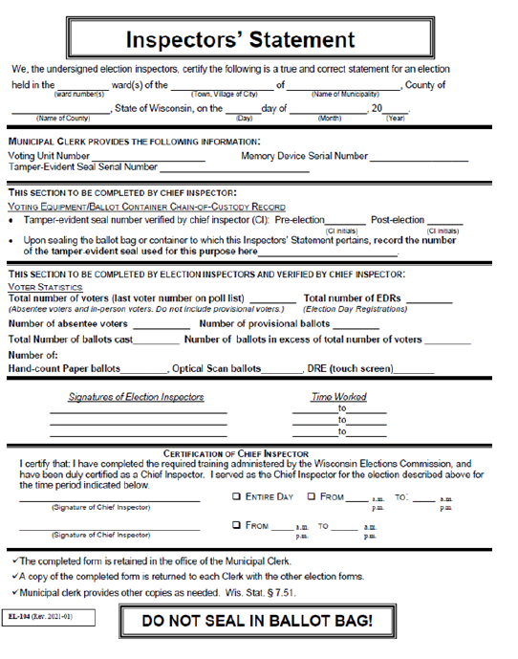
INSPECTOR’S STATEMENT (EL-104)
EVERY blank space should be filled in.
Document any Election Day Incident.
Notes will assist with reconciliation.
ANYTHING unusual should be documented. (ballot jams, using override function, remaking ballots, etc.)
When in doubt, WRITE IT DOWN.
Signed by an odd number of Election Officials
DETAILS-DETAILS-DETAILS

Slide 42
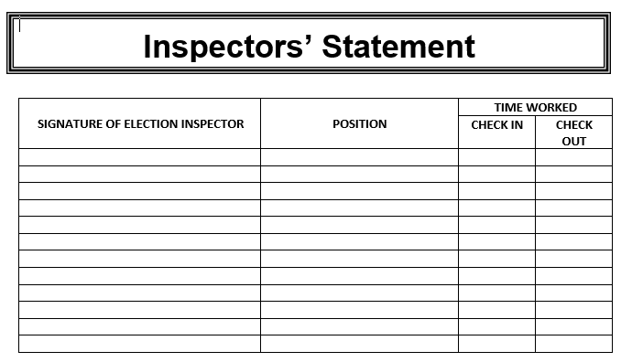
INSPECTOR’S STATEMENT
Second page added. *Election inspectors to sign in and sign out at the beginning of the day, at shift changes, and when breaks are taken. * Election inspectors that are closing the elections will sign on the front page of the Inspector’s Statement.

Slide 43
BOARD OF CANVASS FINDINGS
Poll Books: Use red pen and letter “A” in all Absentee references of voter number. Circle last voter number not page number. Circle last voter number.
Municipal Board of Canvass: Need to do more training on proper way to complete. Election results tape should be on the first page. Not signed Summary page not completed.
Absentee Log: use red ink for voter number. A in front of number.
Certificate of Ballots: Ballots remade by poll workers not voter.

Slide 44
BOARD OF CANVASS FINDINGS
Inspectors’ Statement: Missing Chief Inspector’s initials on chain of custody. Missing ballot bag number. Did inspectors work the entire day? No times reported. Start times/end times? (all inspectors can not possibly end at 8:00pm) Incident report vague – spoiled ballots (over voted, under voted, etc. ?), absentee rejected (why?/outcome) Missing inspector’s signature who worked from 6:30 a.m. – 1:30 p.m. No optical scan ballot number. List second ballot bag number on front of inspectors’ statement as well as on incident log Polls closed late? Chain of custody and voter statistics incomplete If hand count and no equipment is used, equipment information should be “n/a”. Even number of poll workers documented for entire day. (Should be odd number) Date not noted on ballot bag under signatures.

Slide 45
CONFIRM ADDRESS FOR ABSENTEE ENVELOPES
TOWN OF BIRCH | W4762 County Road H, Irma, WI 54442
TOWN OF BRADLEY | PO Box 325, 1518 W Mohawk Dr Tomahawk, WI 54487
TOWN OF CORNING | N1569 State RD 64 Merrill, WI 54452
TOWN OF HARDING | N2567 County RD E Merrill, WI 54452
TOWN OF HARRISON | N10455 County Road D, Tomahawk, WI 54487
TOWN OF KING | W4450 County RD A Tomahawk, WI 54487
TOWN OF MERRILL | W4594 Progress Ave. Merrill, WI 54452
TOWN OF PINE RIVER | N1647 Deer Run Ave. Merrill, WI 54452
TOWN OF ROCK FALLS | W5895 Rock Falls DR Irma, WI 54442
TOWN OF RUSSELL | N5369 State RD 17 Gleason, WI 54435
TOWN OF SCHLEY | W1981 Heineman RD Merrill, WI 54452
TOWN OF SCOTT | PO Box 857, Merrill, WI 54452
TOWN OF SKANAWAN | W3294 Stevenson Rd Irma, WI 54442
TOWN OF SOMO | W10655 Carpenter Road Tripoli, WI 54564
TOWN OF TOMAHAWK | W4 State Rd 86 Tomahawk, WI 54487
TOWN OF WILSON | N10802 County RD CC Tomahawk, WI 54487
CITY OF MEERILL | 1004 E. 1st ST Merrill, WI 54452
CITY OF TOMAHAWK | P.O. Box 479 Tomahawk, WI 54487

Slide 46
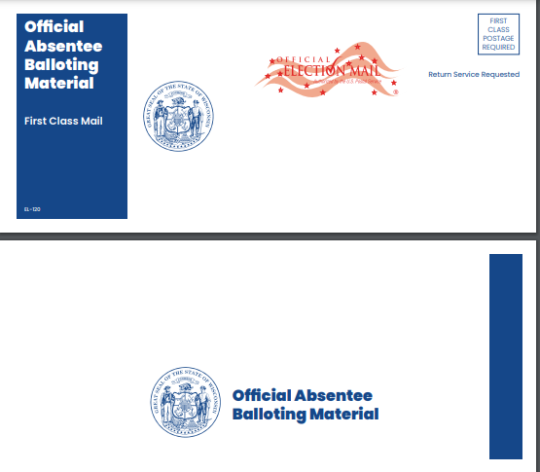
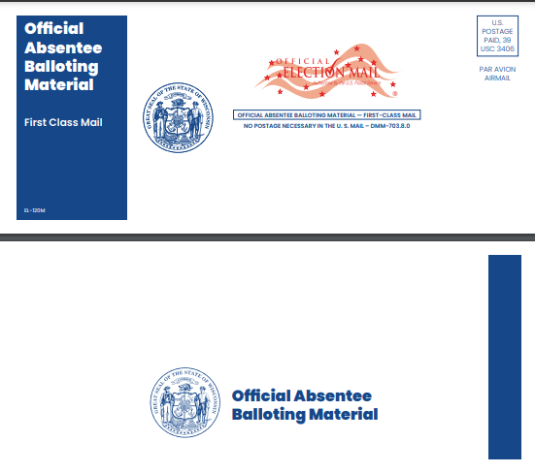
ABSENTEE BALLOT ENVELOPES
Use of only the new absentee ballot materials is mandatory for all 2024 elections.
Absentee Ballot Mailer Envelope EL-120 Military & Overseas Absentee Ballot Mailer Envelope EL-120M

Slide 47
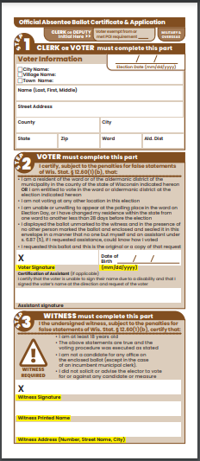
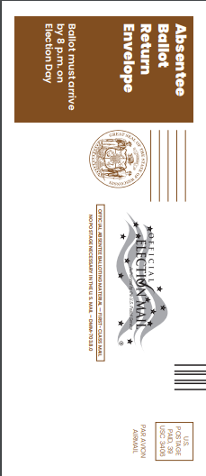
ABSENTEE BALLOT ENVELOPES
Standard Absentee
Ballot Certificate
EL-122
Military and Overseas
Absentee
Ballot Certificate
EL-122M

Slide 48
ABSENTEE BALLOT ENVELOPES
Special Voting Deputy
Absentee Ballot
Certificate
EL-122SVD

Slide 49
MILITARY/OVERSEAS BALLOTS
Presidential Preference “Ballot A”
Only contains Presidential Preference Contest
The only ballot that Permanently Overseas voters will receive.
This is not the same as the Presidential Only ballot used in the November General Election.
Presidential Preference “Ballot B”
Sent out to temporarily overseas voters.
Also contains the Presidential Preference Contest and candidates as well as all other contests with candidates certified form the Spring Primary.
Ballot B will supersede Ballot A if returned. Ballot A will no longer count.

Slide 50
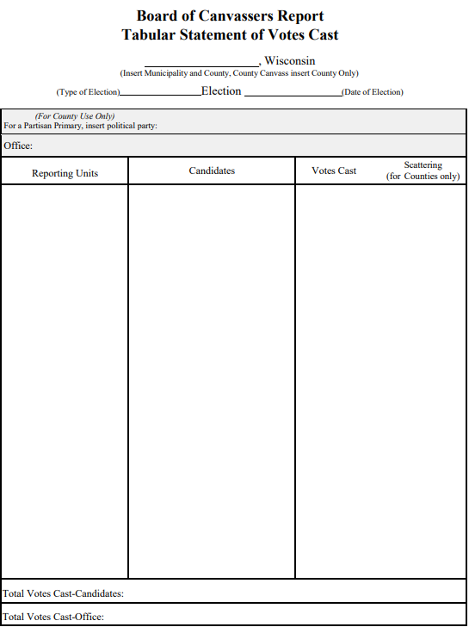
BOARD OF CANVASS TABULAR STATEMENT OF VOTES CAST
Instructions for Municipal Canvass: Used for
• Write the name of your municipality, the kind of election: primary, spring, or special election, etc., and the date of the election in the heading.
• Enter the complete name of the office with the seat or district number in the shaded area.
• List the names of the candidates for the office in ballot order below the shaded area.
• Make sure that all wards or ward combinations are listed in proper numerical order in the left hand column. The smallest number in a combination determines the order. (Example: Wards 1&4; Wards 2,6 & 7; and Wards 3&5.)
• For each reporting unit, list the number of votes cast for each candidate.
• Don’t forget the write-in votes - they must be listed individually by name.
• Enter the total number of votes cast for each candidate in the Total Votes Casts – Candidates column.
• Enter the total number of votes cast (not voters!) for each office in the Total Votes Cast-Office column. This total is the sum of the vote totals for each candidate plus the write-ins

Slide 51
THE FOUR PRINCIPALS FOR COUNTING WRITE-INS

Slide 52
TALLY SHEETS

Slide 53
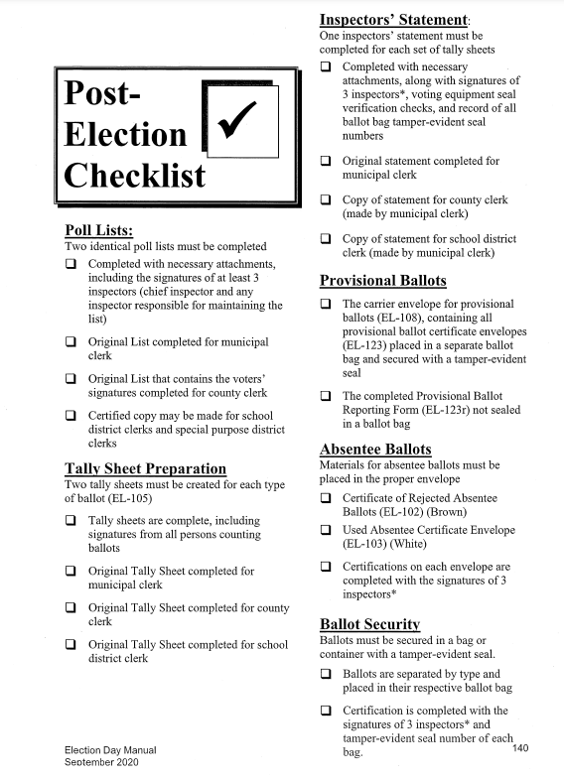
The Post Election Checklist is in your manual. The municipal clerk should provide a copy of this checklist.
This checklist lists some of the materials needed after closing the polls.

Slide 54
ELECTION EMERGENCIES (what if’s)
What if a ballot jams in the voting machine?
What if your voting machine quits working altogether?
Resources:
Election Day Manual
WEC (Wisconsin Elections Commission) 1-866-VOTE-WI – Election Process
ES&S (Election Systems & Software) 1-877-ESS-VOTE – Equipment Issues
County Clerk’s Office 1-715-539-1019
Chris Marlowe’s Cell 1-715-297-7665

Slide 55
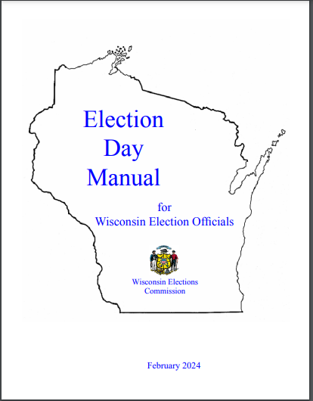
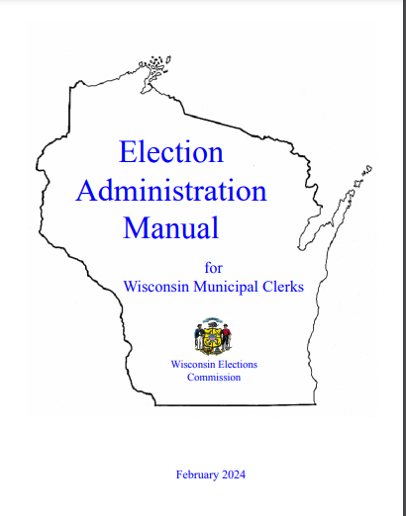
Election MANUALS
The Election Day and Election Administration Manuals have been updated.
Two new sections have been added: “Spoiling and Replacement Ballots” – covers a municipal clerk’s ability to send a new absentee ballot to a voter when returned ballot is spoiled or damaged.
“Voter Correction of Incomplete Absentee Certificate Envelopes” – covers a clerk’s ability to return absentee ballots to voters when there are defects on the certificate envelopes.
Both manuals can be printed from the WEC website or ordered from the WEC or Lincoln County Clerk’s office.

Slide 56
WEC SOCIAL MEDIA CALENDARS
To share important election-related dates and deadlines with voters in your community, the WEC Public Information Office plans to publish a 2024 Spring Primary social media calendar in the coming days. The resource will provide suggested social media posts for you to use on your Facebook, X (formerly known as Twitter), and other social media pages. The Public Information Office will also plan on publishing another social media calendar ahead of the April 2 Spring Election

Slide 57
Non-Confrontation Techniques for Election Workers

Slide 58
ELECTION NIGHT PLAN (AFTER THE POLLS CLOSE)
NORTHERN MUNICIPALITIES
On election night municipalities will transport their black boxes with the media sticks to Sara Park/Bradley Town Hall after polls close and shortly after report tapes are printed. (no later than 8:30pm) and then return to their polling location to complete post election process, if instructed. (Per WI State Statute 5.85 (5), election materials are to be transported by “the municipal clerk or 2 of the election officials by the most direct route..)
Ballots and all other election paperwork should be stored in a secure location overnight. (Additional seals will be distributed for storing ballots and election paperwork in the DS200 bin, if needed)
Deliver ballots and all other paperwork to Tomahawk City Hall the morning of April 3, 2024 between the hours of 8:00am-12:00pm.
SOUTHERN MUNICIPALITIES
On election night municipalities will transport their black boxes with media sticks to the Lincoln County Service Center, County Clerk’s office after polls close and shortly after report tapes are printed and then return to their polling location to complete post election process, if instructed.
The Lincoln County Service Center will be open until 10:00pm on election night for the purpose of delivering ballots and all other paperwork. Ballots and paperwork may also be delivered the following morning to the Lincoln County Clerk’s Office.

Slide 59
QUESTIONS

